Slide 1

IoT Real World Programmable
Blocks with AI
SUBMITTED BY :
Al Sabid
ID No: CSE202503053 Intake: Fall 2025 (Batch-39) Department of CSE, Jahangirnagar University

Slide 2
Presentation Outlines
2
Introduction
Existing System
Drawbacks of Existing System
Proposed System
Why it is preferable?
Applications of IoT Blocks
H/W & S/W Requirements
Methodology
Block Diagram
Circuit Design
E-R Diagram
IOT REAL WORLD PROGRAMMABLE BLOCKS WITH AI

Slide 3
Introduction
3
Building an IoT gadget requires a ton of knowledge, but with IoT Blocks there is no need for expertise in circuits or network programming. With an IoT block in every project, home, or office we can add smart features like motion sensitivity, remote control, orientation monitoring, voice commands, notifications, text messaging, and more.
IOT REAL WORLD PROGRAMMABLE BLOCKS WITH AI

Slide 4
Existing System
4
IoT Smart Home
IoT in Agriculture Monitoring
Google Home Voice Controller
Amazon Dash Button
Smart door Lock
Air Quality Monitor
IOT REAL WORLD PROGRAMMABLE BLOCKS WITH AI

Slide 5
Drawbacks of Existing System
5
The major problem of IoT devices is that they are totally independent, that’s mean each device always performs a specific predefined task.
Fewer configurable options.
For multiple tasks, need multiple apps.
Customization in device function aren’t allowed.
IOT REAL WORLD PROGRAMMABLE BLOCKS WITH AI

Slide 6
Proposed System 1/3
6
Developing few tiny portable blocks that are directly connected to the server and can use them from a central computer by programming for any kind of logical expression.
IOT REAL WORLD PROGRAMMABLE BLOCKS WITH AI

Slide 7
Proposed System 2/3
7
IoT Blocks are consist of five sections:
  Input device blocks (Buttons, Temperature, Motion etc.).
  Output device blocks (LED, Buzzer etc.).
  Python Module.
  Server-side API.
  Database.
IOT REAL WORLD PROGRAMMABLE BLOCKS WITH AI

Slide 8
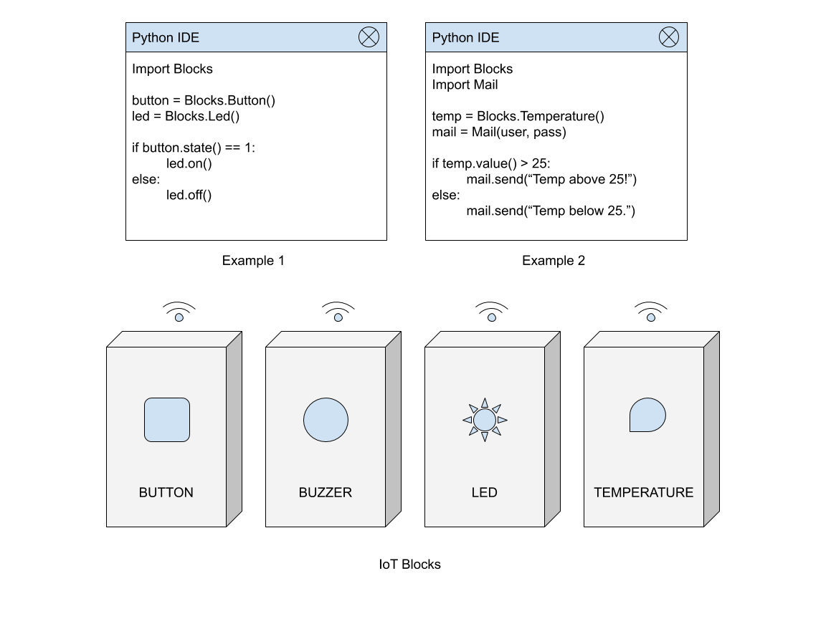
Proposed System 3/3
8
IOT REAL WORLD PROGRAMMABLE BLOCKS WITH AI

Slide 9
Why it is preferable? 1/2
9
Easily can integrate to any environment.
Can apply any logical expression, iteration.
Blocks can be used as single or combined together.
Can be re-programmed on demand.
Its Increases productivity of our daily life.
Teaching programming logics easily to high school students.
IOT REAL WORLD PROGRAMMABLE BLOCKS WITH AI

Slide 10
Why it is preferable? 2/2
10
Simplify large tasks into smaller.
This is very useful for security system in home and office.
Replacement for current smart home automation devices.
No limitation of use.
IOT REAL WORLD PROGRAMMABLE BLOCKS WITH AI

Slide 11
Traditional vs Programmable IoT Blocks:
11
Feature | Traditional IoT Frameworks | Programmable IoT AI Blocks
Interface | Hardcoded C++/Python & Circuitry | Drag and Drop / Natural Language (AI Chatbot)
Hardware Setup | Point-to-point soldering & fixed model. | Modular, reusable physical blocks
Target User | Engineers & Developers | Anyone (Students, homeowners)
Reusability | Hardwired for a single, specific task | Dynamically re-programmable on demand
IOT REAL WORLD PROGRAMMABLE BLOCKS WITH AI

Slide 12
Some Applications of Programmable IoT Blocks:
12
Home Automation
Agriculture Automation
Agro Automation
Factory/Office Automation
Traffic Automation
IOT REAL WORLD PROGRAMMABLE BLOCKS WITH AI

Slide 13
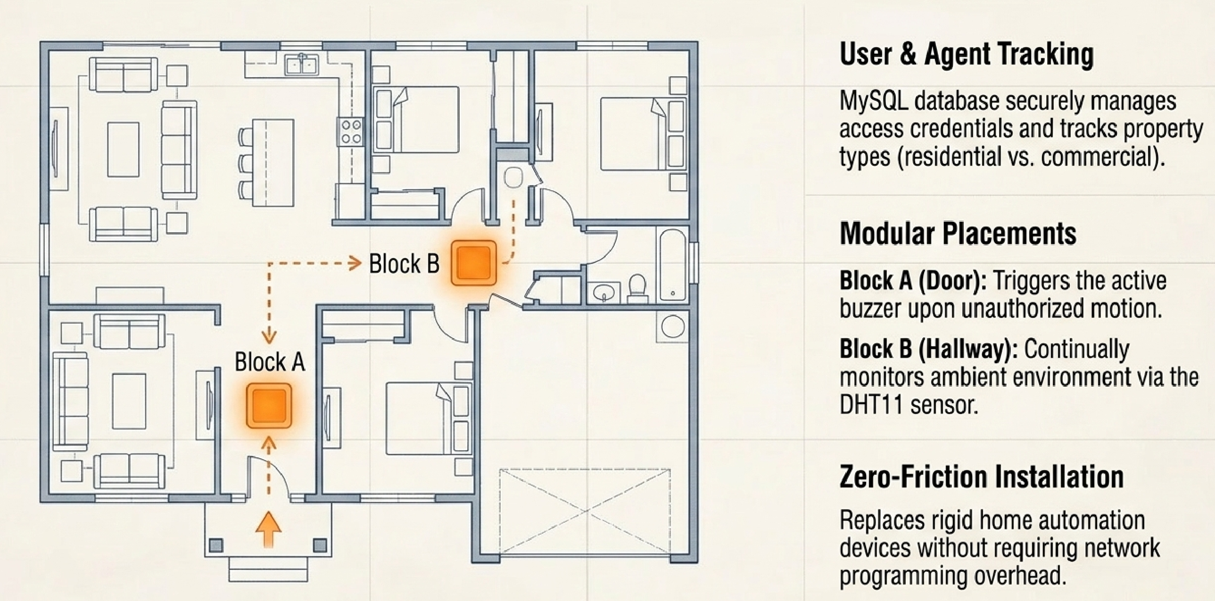
Real-World application: Smart property automation
13
IOT REAL WORLD PROGRAMMABLE BLOCKS WITH AI

Slide 14
H/W & S/W Requirements
14
Hardware
  ESP8266
  Button
  Resistors
  AMS1117
  Buzzer
  DHT11
  LED
  Relay
Software / PL
  Arduino IDE
  Python
  PHP
  MySQL
  Fusion 360
  Proteus 8
  Easy EDA
IOT REAL WORLD PROGRAMMABLE BLOCKS WITH AI

Slide 15
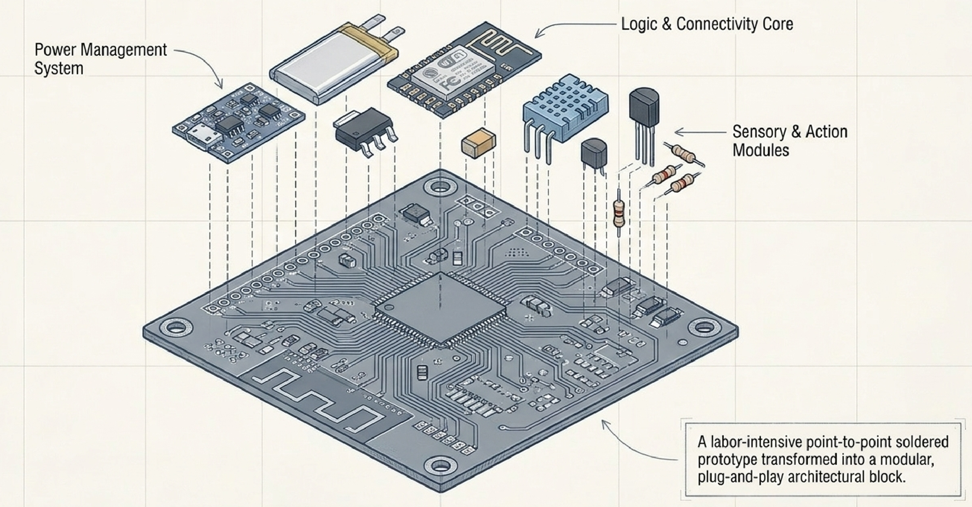
Anatomy of a programmable block
15
IOT REAL WORLD PROGRAMMABLE BLOCKS WITH AI

Slide 16
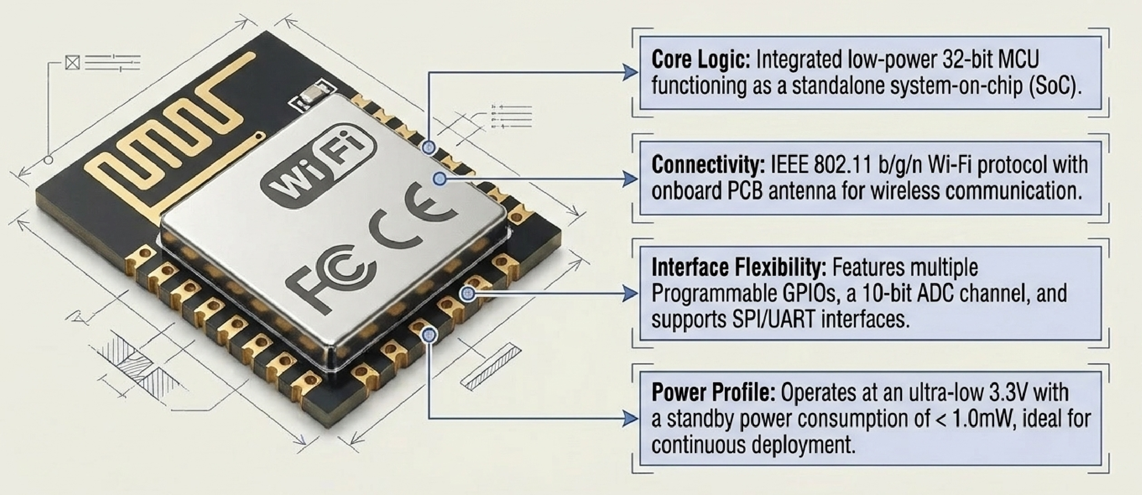
The brain of the block: ESP8266-12E
16
IOT REAL WORLD PROGRAMMABLE BLOCKS WITH AI

Slide 17
Methodology
17
We use MySQL as a database.
Programming languages Python, PHP are used generally.
Arduino IDE for hardware level programming.
3D modelling with fusion 360.
3D prototype casing printing.
API development using lumens framework.
IOT REAL WORLD PROGRAMMABLE BLOCKS WITH AI

Slide 18
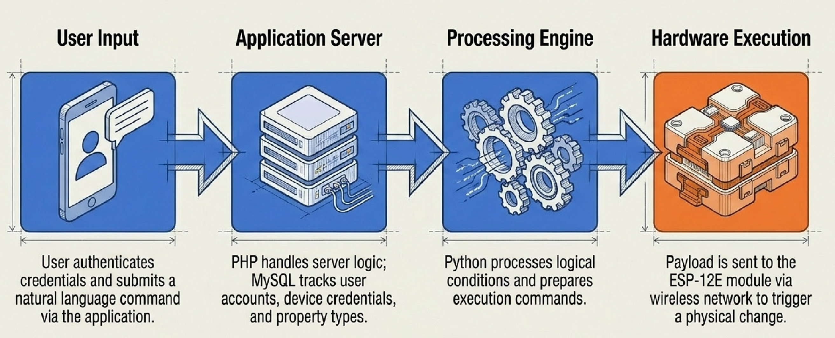
The data pipeline: From chat to physical action
18
IOT REAL WORLD PROGRAMMABLE BLOCKS WITH AI

Slide 19
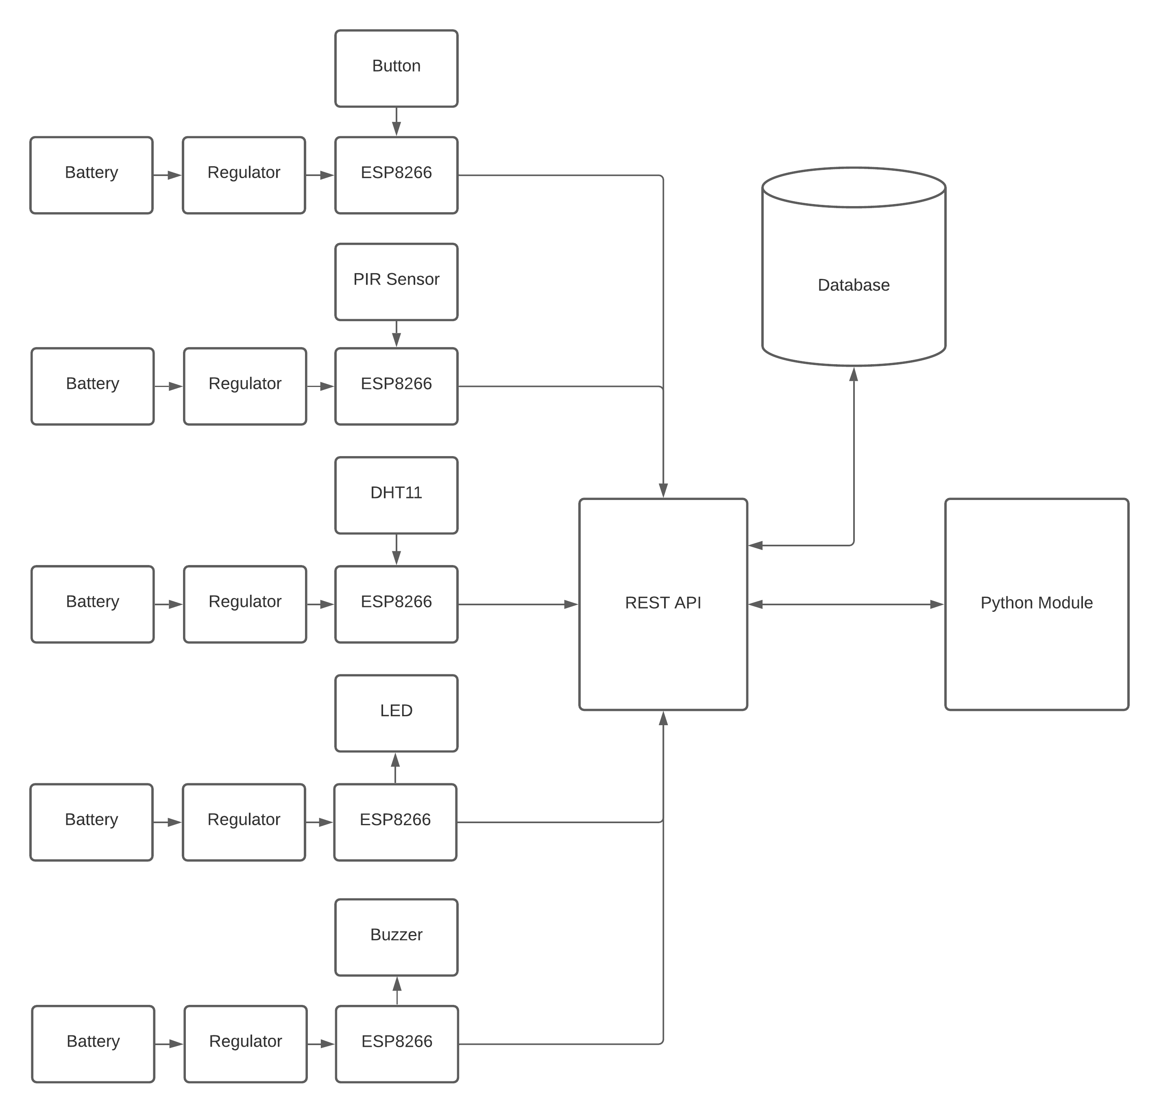
19
Block 01
Block 02
Block 03
Block 04
Block N
Block Diagram
IOT REAL WORLD PROGRAMMABLE BLOCKS WITH AI

Slide 20
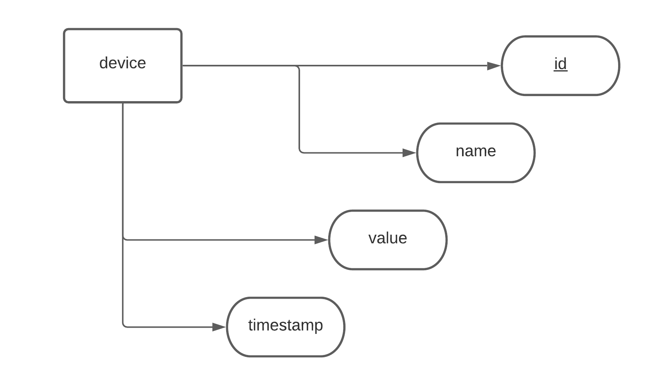
20
E-R Diagram
IOT REAL WORLD PROGRAMMABLE BLOCKS WITH AI

Slide 21
THANK YOU!

